Slide 1
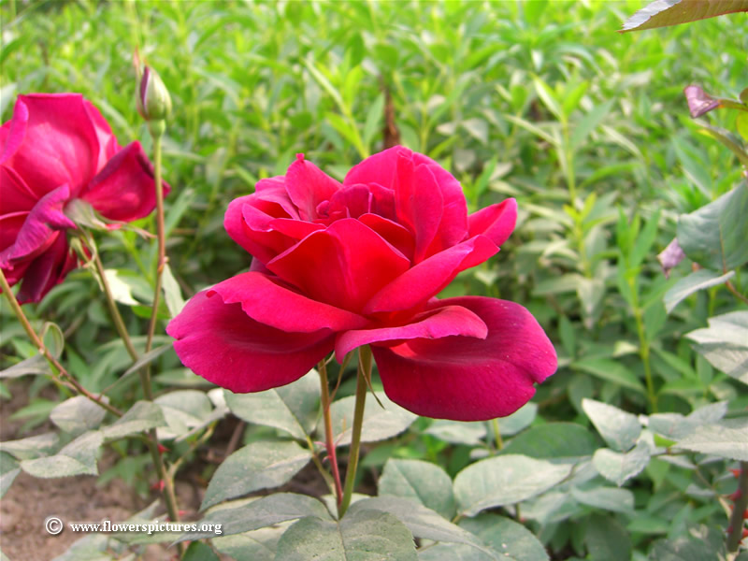
WelCome

Slide 2

INTRODUCTION
Md. Golam Faruque
Asst. Teacher
Magura A,G Academy, Magura.
e-mail: faruquebd80@gmail.com
Mob: 01726424107

Slide 3
Class: Nine
Subject : English 1st Paper.
Unit: Three
Lesson: 6
Time: 50 minuites

Slide 4
Objectives
By the end of the lesson SS will have to
read a newspaper report about Pahela Baishakh
described pictures of the preparation for a mela
planned how to organise a baishakhi mela at your school .

Slide 5
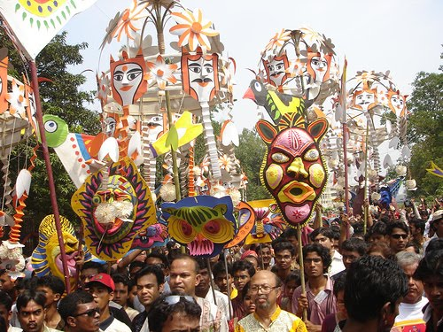
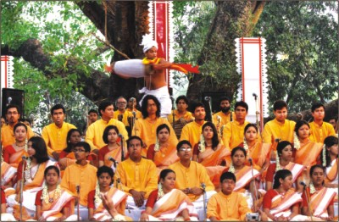
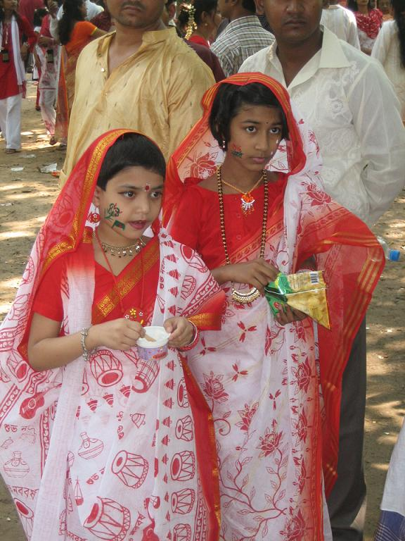
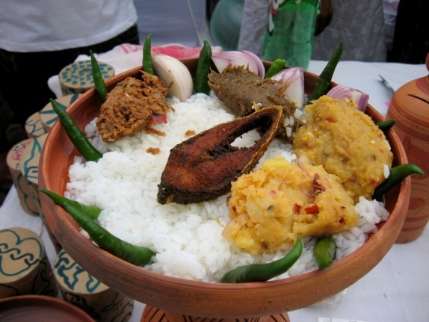
What do you see in the picture?
Rally
Romna Batmool
Traditional dress
Panta Ilish
Today we will learn about Pahela Boishakh.

Slide 6
Guess and answer the following questions-
Which New Year is Masum talking about?
Which Bangla year is this?
When are you going to celebrate pahela baishakh this year?

Slide 7
Synonym of the flowing words
words
Synonym words
Public
Old culture
Tradition
General mass
complementary
Folk song
Pop music
supplement

Slide 8
Ask Ss to read the article of the book about Pahela Boishakh.

Slide 9
Pair Work
The word Pahela means the first and Boishakh is the---------month of Bangla calendar. The day is observed not----------- in Bangladesh but ----------- in some other parts of the world. It is celebrated in west Bengal, Assam Tripura. It is also ----------- in Australia and the UK. In Australia, the largest ------------- for Bangla new year is the Sydney Boishakhi Mela held ------------- Sydeny Olympic Park. In England, the Bangalees------------- celebrate the day with a street ---------------- in London. It is the ----------- Asian festival in Europe, ---------------Bangladesh and West Bengal.
first
only
also
observed
festival
by
gather
situated
largest
held by

Slide 10
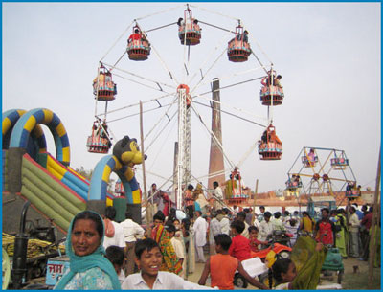
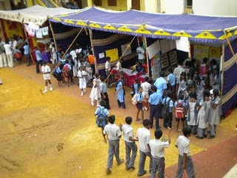
The pictures bellow are taken from different venues where the Baishakhi Mela will be held.
Bangla Academy
School Premise

Slide 11
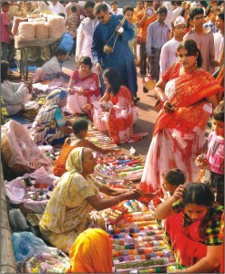
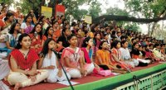
The pictures bellow are taken from different venues where the Baishakhi Mela will be held.
Doel Chotter
Romna Battmool

Slide 12
Group Work
Discuss in groups What preparations you would need to hold a Boishakhi Mela at your school and make a list of the activities you want to have during the Mela.

Slide 13
Evaluation
By asking questions:
Where does the first program of Pahela Boishakh begin?
How do you organise a Boishakhi Mela in your school?
What things do you have to need to arrange a Boishskhi Mela in your school?

Slide 14
Home Work
Write a paragraph about Pahela Baishakh

Slide 15


